Slide 1


Slide 2

Time Management (Scheduling, Multitasking)

Slide 3
Definition of Time Management
Conceptual Overview
Time management refers to the process of planning and exercising conscious control over the amount of time spent on specific activities, aiming to enhance efficiency and productivity.
Scheduling Importance
Effective time management involves scheduling tasks to allocate appropriate time slots for each activity, ensuring that deadlines are met and priorities are addressed.
Multitasking Dynamics
While multitasking can increase productivity, it requires careful management to avoid diminishing returns; understanding when to multitask and when to focus on single tasks is crucial for effective time management.

Slide 4

Key Components of Time Management
Effective Scheduling
Scheduling is a fundamental component of time management that involves creating a structured plan for tasks and activities, allowing individuals to allocate specific time slots for each responsibility, thereby enhancing focus and efficiency.

Slide 5
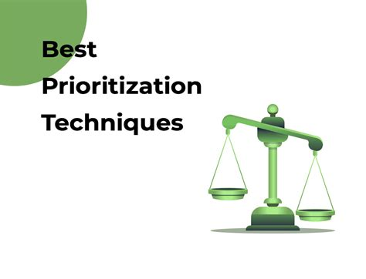
Prioritization Techniques
Utilizing prioritization methods, such as the Eisenhower Matrix or ABCD Method, helps individuals identify urgent versus important tasks, ensuring that critical activities are addressed first and resources are allocated effectively.

Slide 6

Mindful Multitasking
While multitasking can be beneficial, it is essential to approach it mindfully; understanding the limits of cognitive load and recognizing when to switch between tasks can prevent burnout and maintain productivity levels.

Slide 7
Common Time Management Challenges
Scheduling Conflicts
One of the primary challenges in time management is dealing with scheduling conflicts, where overlapping commitments can lead to missed deadlines and increased stress. Effective prioritization and clear communication are essential to mitigate these issues.
Ineffective Multitasking
Many individuals struggle with multitasking, often believing it enhances productivity. However, frequent task-switching can lead to decreased efficiency and increased errors, highlighting the need for focused work periods and strategic task management.
Procrastination Tendencies
Procrastination is a common barrier to effective time management, often stemming from fear of failure or overwhelming tasks. Developing strategies to break tasks into smaller, manageable steps can help combat procrastination and improve overall productivity.

Slide 8
What Is A Schedule?
A schedule is a plan that lists down your activities to help you prioritize your time and achieve your goals.
Importance of Scheduling and Time Management
When done correctly, scheduling helps you make the most of your available resources. A schedule is important for the following reasons:
Better Work-Life Balance: Activities like medical appointments, meal planning, family time, and sleep are just as important as our jobs and businesses. Scheduled tasks allow us to plan our lives better, so work priorities don’t interfere with personal responsibilities and vice versa.
Managing Workload: Scheduling also helps us to take on tasks that we can handle effectively. Otherwise, we may end up with too much on our plates, which leads to increased stress and dissatisfaction.

Slide 9
Meeting Deadlines : Time is money when delivering to your clients and maintaining good customer relationships. Scheduled tasks can improve efficiency if you consistently miss deadlines or lose leads.
Steady Progress Towards Your Goals: You can schedule days, weeks, hours, and even years to set short-term and long-term goals. A good schedule also accommodates contingencies to keep you on track with your targets.
Accountability: Work schedules ensure that everyone on the team receives the correct tasks and time allocation to level the playing field. Transparent work schedules also reassure the team that there’s no favoritism in shift or task allocation.
Happier Teams : A good schedule encourages collaboration since operations run like clockwork, and every team member plays their part. It also opens communication so teams can adjust their schedules without severely impacting their productivity.

Slide 10
Planning Vs Scheduling
A common misconception is that scheduling and planning are the same things. In fact, they are very different. The difference between planning and scheduling is:
Planning – Preparing a list of tasks in a set order of completion to get something done. Often described as the steps required to achieve a goal that you have. Making a plan might also be described as a statement of intent. For example, ‘I’m going to the supermarket this afternoon’ is a plan.

Slide 11
Scheduling – Scheduling is less about what is being done and why, but more about when. Plans may not have times and dates set against them, but a schedule does. Scheduling is where we take the plan then begin to ‘plugin’ the tasks we have into the time we have available — for example, adding them to a calendar or planner.
Once we plan our time effectively, then we should schedule our time effectively too. As you can see, they are two very different things. You will find it very difficult to schedule your time if you don’t plan your time effectively first.
Essentially, we don’t plan our time. we plan our tasks and the schedule is where we plan the time we will use to complete these tasks. Without a schedule, a plan just becomes a list of tasks that will not drive us towards completing them.

Slide 12
How to Plan Your Time Effectively
Here are some simple steps to help you schedule your time effectively:
Make a plan. Follow the steps in this article to make a simple plan of all of the tasks that you need to complete
Break tasks down into smaller tasks. If you have any large tasks (say over one hour in length), break these down into smaller tasks. You can do this by looking for the natural breaks or milestones in the task and splitting them there.
Create a planner. Use a blank calendar, day to a page diary or create a template using Microsoft Excel or Word that shows the days of the week and 1-hour slots for your working day for each day

Slide 13
Add in your lunch and other breaks. Treat lunch and breaks as tasks to remind you to take these each day
Start with your regular tasks. Identify from your plan in step one the tasks that are regular or repeatable tasks. Look at the deadlines, give yourself some contingency time and decide when they will be done (you’re aiming to do these at the same time, on the same day each week or month)
Block out the time for your most important tasks. Add your tasks to your planner by blocking out the time. You should make it clear what the task is. You could also add a priority to each task to show how important it is

Slide 14
Add the least important tasks. Add your least important tasks into your planner, filling the gaps between your more important tasks.
Move things around as things change. If something changes, for example, you get a new one-off task, work out where it goes. Add it into a gap, move things around or, if you don’t have space, remove some of your least important tasks to make room for it (but only if this new task is more important than them).

Slide 15
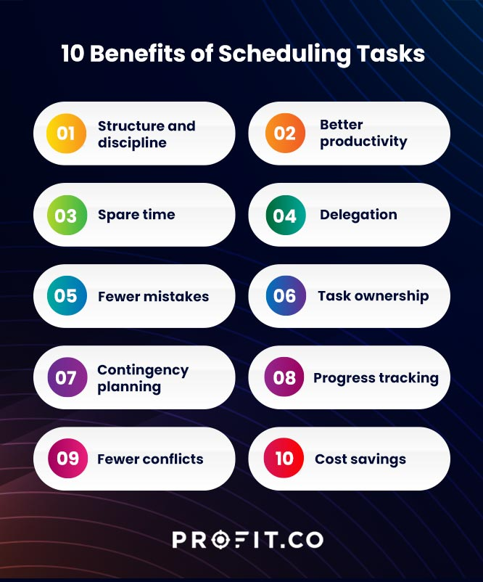

Slide 16
How To Schedule Your Tasks
Follow the steps below to plan your schedule effectively:
Step 1: Determine a reasonable time frame for your tasks to achieve your goals. Example: Suppose you need extra hours to study a part-time course. In that case, a flexible schedule can allow you to start work early and finish early, then spend evenings studying.
Step 2: List all of your tasks and assignments
Identify essential tasks and responsibilities that drive your success. Example: HR managers must schedule supervision, coaching, and conflict resolution time.
Step 3: Prioritize these tasks to determine what’s urgent or unavoidable, then schedule them based on EISENHOWER MATRIX criteria. Example: If you’re most efficient in the morning, schedule the most challenging tasks for the morning hours.

Slide 17
Step 4: Leave the least urgent tasks for last — schedule less important tasks that don’t require immediate attention, like organizing files or responding to non-urgent emails, toward the end of your workday or week. By saving these tasks for later, you can spend time on more important ones when you’re performing at your best. Slotting smaller tasks throughout the day to give yourself more variety is also an effective option.
Step 5: Add contingency time in your schedule to deal with emergencies and distractions which may cause you to work too late. Example: Schedule time for travel delays if your job is unpredictable or adventurous, like tour management.

Slide 18
Step 6: Plan the discretionary or unscheduled time after completing your scheduled tasks. Example: If you find a free half-hour in your workday, use this time to evaluate your goals or get a head start on future projects.
Step 7: Assess your schedule if there’s little to no discretionary time left, which may indicate unnecessary tasks in your plan. Example: If there’s no free time left in your day, consider delegating, outsourcing, or automating tasks.
Step 8: Analyze your schedule and activities

Slide 19
Methods for scheduling time
The Most Important Task method (MIT): to focus on only the important tasks rather than a long list. When using this method, evaluate the top three most important goals and give them your full attention throughout the day.
The time blocking method
In the time blocking method, you to plan your tasks and assign time lengths to accomplish them. This method increases productivity and helps limit your choices of tasks. Knowing in advance what you want to complete and when may help you create a reference calendar to use when deciding when to start and finish a task. To make the time blocking method effective, try scheduling your tasks into two categories which are:
Proactive blocks: Important tasks you must complete before the end of each day
Reactive blocks: Tasks you can focus on when you have spare time, like answering emails and checking notifications

Slide 20
The Pomodoro Technique
The 90-minute focus technique
The 90-minute focus technique teaches you how to focus on the moments when you experience high and low energy levels. This technique uses ultradian rhythms, which are biological cycles that usually occur within 24 hours. The human body experiences high energy and low energy during the cycles. Working for 90 minutes and resting for about 20 to 30 minutes in between each group may help you coordinate with your optimal energy levels to achieve tasks and increase your productivity. The exact timing may be different for everyone, so monitor your energy levels to find your own unique pattern.

Slide 21
Time estimation methods
When meeting deadlines and completing tasks, time estimation may be an important skill for understanding the time period in which you'll complete a project.
Some specific estimation techniques include:
Expert judgment: Talking with people who have experience working on the same tasks can help you approximate an appropriate timeline for your project completion.
Analogous estimation: Studying previous projects may help you estimate an appropriate deadline for an upcoming one.

Slide 22
Parametric estimation: Similarity to analogous estimation, you can use logical parameters to estimate how long it may take you to complete a task. For example, if you take 20 minutes to calculate the salary of 50 employees, you may conclude that it takes 40 minutes to calculate the salary of 100 employees.
PERT estimation: Using three logical averages—the most optimistic (o), most pessimistic (P) and most likely (M)—within a mathematical formula may help you determine how long it takes to complete a project.
The formula is:(O + P + 4 * M) / 6 = PERT estimation

Slide 23
The 52-17 rule
The 52-17 rule is like the Pomodoro Technique, but has a different set of intervals for work and rest. With this method, you work for 52 minutes and take a break for 17 minutes. This method may be ideal for those who like to work and rest at longer intervals than 25 minutes.
Conduct a time audit
start by assessing where you actually spend your time. Create a visual map of the approximate hours you spend on work, school, housework and chores, commuting, social media, and leisure activities.
Set goals based on this outcome. Planning ahead and setting time limits on your tasks and priorities.

Slide 24
The duration compression technique
The duration compression technique can help you shorten your schedule without reducing the quality of scope of a project.
There are two subcategories of the duration compression technique:
Fast-tracking: Helps increase the project's speed by completing tasks simultaneously
Crashing: Adds more resources to complete the project on time

Slide 25
The circadian rhythm technique
The circadian rhythm is a 24-hour biological process that regulates your waking and sleeping patterns and may affect your physical body, mental state and behavior. In the traditional cycle, when you wake up, your energy levels rise naturally. Those who work a traditional eight-hour daily schedule may reach peak concentration around 10 a.m. They may experience low energy levels between 1 p.m. and 3 p.m. with another rise in the late afternoon and evening. Finally, the levels may drop between 9 p.m. and 11 p.m., before bed. To use this rhythm to your advantage, consider
:Performing your most time-consuming tasks between 10 a.m. and 1 p.m.
Conducting less thought-intensive projects, such as responding to emails or phone calls, from 1 p.m. to 3 p.m., during the afternoon lull
Returning to more involved activities, such as exercise, between 3 p.m. and 9 p.m.

Slide 26
Creating a Daily/Weekly Schedule
Establish Clear Goals
Begin by defining specific, measurable goals for the day or week, which will guide your scheduling process and ensure that your time is allocated effectively towards achieving these objectives.
Time Blocking Technique
Utilize the time blocking method to allocate dedicated time slots for different tasks or activities, minimizing distractions and enhancing focus by creating a structured routine that promotes productivity.
Regular Review and Adjustments
Implement a routine for reviewing your schedule at the end of each day or week, allowing for adjustments based on completed tasks and unforeseen events, ensuring that your scheduling remains flexible and effective.

Slide 27
What are Multitasking Skills?
Multitasking skills refer to the capability to handle multiple tasks at once and complete them simultaneously. In essence, it’s about learning how to multitask effectively. With regular practice, managing many tasks can become less challenging and more efficient. Every project offers an opportunity to enhance your multitasking skills.

Slide 28
Benefits and Drawbacks of Multitasking
Increased Efficiency Potential
Cognitive Overload Risks
Context-Dependent Outcomes
Strategies for Effective Multitasking
Prioritize Tasks Wisely
Set Time Limits
Minimize Distractions
Notes:
Increased Efficiency Potential
Multitasking can lead to a perception of increased efficiency, as individuals may feel they are accomplishing more in a shorter time frame; however, this often comes at the cost of quality and thoroughness in task completion.
Cognitive Overload Risks
Engaging in multiple tasks simultaneously can overwhelm cognitive resources, resulting in decreased focus, increased errors, and ultimately, a decline in overall productivity and effectiveness in task execution.
Context-Dependent Outcomes
The effectiveness of multitasking is highly context-dependent; while it may be beneficial for simple, routine tasks, it can be detrimental for complex or creative tasks that require deep concentration and critical thinking.
Strategies for Effective Multitasking
Prioritize Tasks Wisely
Begin by identifying and ranking tasks based on urgency and importance; focus on high-priority tasks first to ensure that critical responsibilities are addressed without compromising quality.
Set Time Limits
Allocate specific time blocks for each task to maintain focus and prevent distractions; using techniques like the Pomodoro Technique can enhance productivity by encouraging short breaks between focused work sessions.
Minimize Distractions
Create a conducive work environment by eliminating potential distractions, such as notifications from devices or unnecessary interruptions, allowing for a more streamlined multitasking experience that enhances overall efficiency.

Slide 29
When to Avoid Multitasking:
Complex Task Requirements : Multitasking should be avoided when tasks require deep concentration or critical thinking, as switching between tasks can lead to cognitive overload and diminish the quality of work produced.
High-Stakes Situations: In scenarios where the consequences of errors are significant, such as in medical or legal fields, focusing on a single task is essential to ensure accuracy and thoroughness, thereby reducing the risk of mistakes.
Learning and Skill Development: When acquiring new skills or knowledge, it is crucial to dedicate full attention to the learning process; multitasking can hinder comprehension and retention, ultimately slowing down personal and professional growth.

Slide 30
Avoiding Multitasking Traps
While multitasking may seem tempting, it can lead to reduced productivity and lower-quality work. Avoid these common multitasking traps:
Task Switching: Jumping between tasks can slow you down and decrease your focus. Instead, complete one task before moving on to the next.
Constant Email Checking: Constantly checking your email can interrupt your flow and decrease productivity. Set specific times to review and respond to emails instead.
Overlapping Similar Tasks: Trying to multitask similar tasks may cause you to confuse details or make errors. Focus on one task at a time to maintain accuracy.
Multitasking During Important Conversations: Avoid multitasking while engaged in important conversations. Give your full attention to the person you are talking to, which shows respect and enhances communication.

Slide 31
Overcoming Challenges in Multitasking
1. Dealing with Overwhelm
Multitasking can quickly lead to feelings of overwhelm as you juggle multiple tasks at once. To tackle this challenge, consider the following strategies:
Prioritize Tasks: Identify the most critical tasks and tackle them first. Breaking down your to-do list into smaller, manageable tasks can make overwhelming projects seem more achievable.
Set Realistic Expectations: Be honest with yourself about what you can realistically accomplish. Avoid taking on more tasks than you can handle in a given timeframe.

Slide 32
Practice Time Management: Use techniques like the Pomodoro Technique (mentioned earlier) to work in focused intervals, followed by short breaks. This method can help you stay organized and reduce overwhelm.
Ask for Help: Don’t hesitate to delegate tasks when possible. If you have colleagues or team members who can assist, distribute the workload to avoid feeling overwhelmed.
2. Handling Interruptions
Interruptions can disrupt your multitasking efforts and hinder productivity. Here’s how to handle them effectively:
Create a Dedicated Workspace: Establish a designated workspace where you can minimize interruptions. Inform others that when you’re in this space, you need focused time to work.

Slide 33
Set Boundaries: Politely communicate your work hours to family, friends, and coworkers. Ask them to respect these boundaries and avoid unnecessary interruptions during these times.
Use “Do Not Disturb” Mode: Utilize the “Do Not Disturb” feature on your phone or computer to silence notifications during critical work periods.
Schedule Breaks for Interaction: Allocate specific times for socializing or responding to non-urgent messages. This way, you can stay connected without derailing your multitasking efforts.

Slide 34
Tips for Continuous Improvement in Time Management
Regular Self-Assessment
Conduct periodic evaluations of your time management practices to identify areas for improvement; reflect on what strategies are working, what challenges you face, and how you can adjust your approach to enhance efficiency.
Set SMART Goals
Establish Specific, Measurable, Achievable, Relevant, and Time-bound goals to provide clarity and direction in your time management efforts; this structured approach helps prioritize tasks and track progress effectively.
Embrace Technology
Utilize time management tools and apps to streamline scheduling and task tracking; leveraging technology can enhance organization, reduce manual effort, and provide reminders to keep you on track with your commitments.

Slide 35
What is a key benefit of scheduling?
A) Eliminating the need for prioritization
B) Providing a structure for managing time effectively
C) Overloading yourself with tasks
D) Avoiding breaks to save time
2) What is the most important aspect of an effective schedule?
Flexibility
Filling every hour with tasks
Leaving no room for changes
Scheduling the least important tasks first
3) Which of the following is a recommended method for creating a schedule?
Scheduling back-to-back tasks without breaks
Scheduling the hardest tasks during your most productive hours
Not planning any tasks ahead of time
Ignoring deadlines and focusing only on urgent tasks
Notes:
Ans:
B
A
b

Slide 36
4) Which one of the following does not come under the time management model?
Time keeper
Time manager
Doers
Perfectionists
5) What is a common effect of multitasking?
Increased focus and productivity
Improved task quality
Reduced efficiency and task quality
Greater creativity
6) What is the recommended strategy for managing multiple tasks?
Doing them all at the same time
Prioritizing and focusing on one task before moving to the next
Switching between tasks frequently to stay engaged
Avoiding scheduling them
Notes:
Ans:
4) A
5) C
6) b

Slide 37
THANK YOU

